Slide 1
Sankofa, looking back to move forward: Mitigating Bias, Building Dialogues, and Preparing for 2025 and Beyond
Presented at the AAC&U Annual Meeting, January 2025
Presented by:
Ande Diaz, Ph.D.
Chief Diversity Officer, Emerita,
Saint Anselm College
VP of Tree of Light Consulting Guild
Rhonda Fitzgerald,
Executive Director
Sustained Dialogue Institute
Notes:
Original subtitle was: Mitigating Bias, Building Dialogues, and Preparing Post-election Conversations,
Reason we call it Sankofa is a word in the Twi language of Ghana meaning “to retrieve" (literally "go back and get"; san - to return; ko - to go; fa - to fetch, to seek and take)

Slide 2
.
Welcome! Connecting with one another…
With facilitators…
With each other…
Take a moment to think/jot down your responses, then share:
Your name, work community (organization) or home community
What brought you to this workshop?
What’s one thing looking back in the last 5 years that gives you hope in terms of progress for a community in which you participate?”
Notes:
(4 minutes) Welcome, Facilitator Intros
(8 min) CONNECT:
Take a moment to think
Move to groups of 2-3,
Name, home institution or town
What brought you to this workshop?
What’s one thing looking back in the last 5 years that gives you hope in terms of progress for a community in which you participate?”

Slide 3
.
Overview of Agenda
Welcome and connecting with one another
Looking back on the Last 5 Years
Community Summaries:
A racial justice case-study
Your community experience
Moving Forward
Sustained intergroup engagement
Assessment: Recognizing the “long tail” of change
“Tools to go”
Notes:
AGENDA: (total 55 min)
Connecting (5min)
Agenda review (2 min)
Looking back on 5 years (5 min)
Community Summaries
Case study - 5 min
Your experience - 10 min
Moving Forward (10 min)
Sustained intergroup engagement: proven (5 min)
Recognizing the long tail of change/assessment (5 min)
Appendices/ Tool Kit provided by SD (8 min)

Slide 4
.
Looking Back on the last 5 years
Sharing Your Look Back (in pairs 5 min total)
Prompt: Share what you’ve seen for up to 2 minutes each uninterrupted, while the other just listens without judgment:
How have you seen progress, change, or responses LOCAL justice and social justice movement generally? What would you tell a friend who doesn’t work in your field about what you saw and what happened on your campus(es)? How do you think and talk about progress since then?
Notes:
Looking back - (5 mins) Sharing Your Look Back on the Last 5 Years (5 minutes)
Sample prompts to help:
How have you told the story of your campus’ response to the justice movements that sparked in 2020?
What something you saw that was new?
What’s your narrative of progress since 2020 locally? What did you witness?
Based on what you saw anecdotally and any assessment that you’ve seen from your campus, what’s the story of progress that can be told?

Slide 5
.
Community Summaries: ANRJ Case
Anselmian Network for Racial Justice: ANRJ
Context: PWI in NH Hampshire, Catholic College, Liberal Arts with Schools
Components used in our Community Grassroots Response: Initial working groups (e.g. affinity group dialogue model, curricular, co-curricular, parenting and resource groups, policy review)
Leadership Team drawn from 40 employees and 100 + students
Strengths: An inclusive movement. Shared leadership and empowering
Limitations: Sustaining (bent under the weight) Doing vs. communicating about the doing…
Assessment: (the “long tail” of change)
2023 Campus Inventory as a way to maintain community momentum
2024 Leadership Insights (qualitative study)
Notes:
CASE Study: (AD 5 minutes)
The components used in our Community Grassroots Response:
Background Launched in spring 2020
Grassroots leadership team stepped forward
40 faculty and staff in working groups and approximately 100 students launching a social media campaign and advocating for curricular change
about what ANRJ looked like at SAC, context of institution (PWI, Catholic) grassroots community response
Leadership Team, initial working groups (e.g. affinity dialogue model, curricular, co-curricular, parenting and resource groups, policy review)
Strengths: An inclusive movement. Shared leadership and empowering
Limitations: Sustaining (bent under the weight) Doing vs. communicating about the doing…
2023 Inventory and report as a way to maintain community momentum (“long tail later)
Current research shared separately

Slide 6
.
Community Summaries: Your experience?
Prompts: Looking back to 2020 (and the years immediately following) write your responses to:
What inspired your involvements?
What was your role? What did you differently at the time?
What is something that you know came out of that time?
What is one way you would like to help others in your community look back at that time or move forward?
- - - - - - - - - - - - - - - - - - - - -
BELOW
Note your institution/organization
Note what are some ways you did assess or would like to assess – support telling that story (with data? Collaborations? Other ways to capture that community learning?
Notes:
10 minutes (RF with AD)
Explain instructions, Fold and tear bottom half. Post the top half for Rhonda to lead gallery walk.
Drop the bottom half to Ande to review/sort for themes and assessment lessons learned

Slide 7
.
Moving Forward…
What 1-2 transformative initiatives can my campus take? (e.g, media lit courses or ongoing intergroups service or dialogues etc.) What’s 1-2 steps I can take to encourage that? (e.g. go for coffee with faculty senate president to plant seeds for staffing?)
What types of sustained (ongoing) intergroup contact would you like to see to look back together and illuminate different perspectives? (e.g. shared service work, dialogue groups, common first year experience or senior capstones?)
Notes:
Moving Forward: Large group convo (RF lead total of 10 min?)
What types of ongoing intergroup contact (i.e. service, dialogue groups) would you like to see to look back together and illuminate different perspectives on political progress?
What 1-2 transformative initiatives can my campus take? (e.g media lit courses or ongoing intergroups service or dialogues etc.) What’s 1-2 steps I can take to encourage that? (i.e. go for coffee with faculty senate president to plant seeds or staffing)

Slide 8
.
sustained intergroup engagement: proven
50+ years of prejudice-reduction research (post WWII)
30+ years of intergroup dialogue assessment
5 domains of civic impacts (cognitions, behaviors, skills etc.)*
Multiple models (Essential Partners, Sustained Dialogue, Everyday Democracy etc.)
Shared common purpose - currently exists at multiple scales from regional (New Hampshire Listens) to national (VISTA and Peace Corps)
Introduced to campus and community groups using SMART Goals*
* Note: Diaz, A. and Perrault, R. “Sustained Dialogue and Civic Life: Post college impacts” Michigan Journal of Community Service Learning, U. of Michigan. Fall 2010 issue.
** Note: Doran, G., 1981. (stands for specific, measurable, attainable, realistic, and timely)
Notes:
make the case that there are decades of assessment that this works…) (AD under 5 minutes)

Slide 9
Recognizing the long tail of change: assessing a social justice network
Quantitative: Campus Survey
The Anselmian Network for Racial Justice (ANRJ) aims to foster racial justice through education, dialogue, and action.
Grassroots movement 40 employees and 100 students in racial affinity dialogues and other working groups.
Inventory found 56 new/revamped efforts…and 3000 participants over 2 years.
20 curricular efforts/32 courses
Qualitative: 5 open-ended questions
Leadership Insights (14 faculty/staff/admin)
Analyzed for civic domains: Cognitions, Attitudes, Behaviors, Skills, and themes of Individual/Institutional Change:
Deepened awareness of racial justice.
Empowerment to initiate/lead lasting change.
Continued commitments to advocacy
Integration of DEIJ efforts into hiring, curriculum, and co-curricular programs.
Establishment of a culture of inclusion
Infrastructure for dialogue/sustained learning, creating shifts in attitudes and actions.
"I helped develop a … framework [for] faculty to infuse social justice into their teaching.” – faculty
“The network … mobilized the campus, making next steps easier and less controversial.” –admin.
Notes:
Name the “long tail”. Anecdotal gave me hunches. Year’s later, happy to share assessment. (AD in 5 minutes)
ANRJ Launched in spring 2020
Grassroots leadership team stepped forward
40 faculty and staff in working groups and approximately 100 students launching a social media campaign and advocating for curricular change
Assessment began in 2022 with Campus Inventory (community reflection led to in broad campus inventory) CREATE SUMMARY
In 2024 the CDO retired from the college and applied for an IRB approved research study…. Collected data over the last month and preliminary findings are in process. Also anecdotally,
Anecdotal “stories”, surveys, and more
Story 1: Faculty take Civil Rights Tour (GA, AL, TN)
Story 2: Racial equity parenting group from alumni and faculty
Story 3: Inventory toward Curricular reform – new College wide Learning Outcome on Equity
Equity in Retention Institute and Recommendations… my successor the Senior Inclusion Officer…leading that work…

Slide 10
Taking the long view: tools for 2025 and beyond
Sustained Dialogue tools to approach political conversations
Dialogue about media source guide
Notes:
Goal: now that you’ve lived through 2024, here’s a way to approach political conversations drafting from Sustained Dialogue resources
Framing identity sheet
Mini-series samples
Intent vs. impact (maybe with media/bias examples)
(maybe multipartiality handout?)

Slide 11
APPENDICES: (sign-up sheet for specific interests/?)
Political IdentiTree
Unconscious Bias
Media Bias
Tool Kit provided by Sustained Dialogue
Intent vs. Impact
Racial Justice Network Inventory
Contact Info:
Ande Diaz, Ph.D. Email: andediaz@gmail.com Phone: (781) 267-2017
Rhonda Fitzgerald: Email: Rhonda@sustaineddialogue.org

Slide 12
Source: James Madison University
Notes:
Source:
Political IdentiTree: How social identities provide a lens to understand who we are & the impact of our political actions
By Dr. Carah Ong Whaley, associate director, JMU Civic
James Madison University

Slide 13
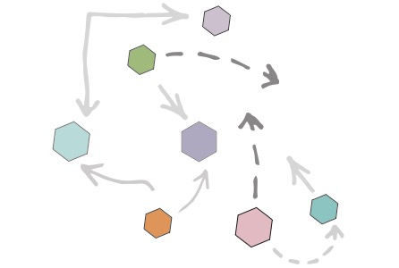
Unconscious Bias
Affinity Bias we unconsciously prefer people who share qualities with us/someone we like
Beauty Bias many of us judge others harshly based on their physical attractiveness
Conformity Bias when our views are swayed too much by those of other people
Confirmation Bias people primarily search for bits of evidence that back up their opinions, rather than looking at the whole picture. It leads to selective observation,
Contrast Effect when we assess two or more similar things and compare them with one another, rather than looking at each based on their own merits- causes harsh judgement and unattainable standards
Gender Bias stems from our deep-seated beliefs about gender roles and stereotypes.
Halo Effect focus on one particularly great feature about a person blinds us to other qualities
Horns Effect focus on one particularly negative feature, which clouds our view of other qualities

Slide 14
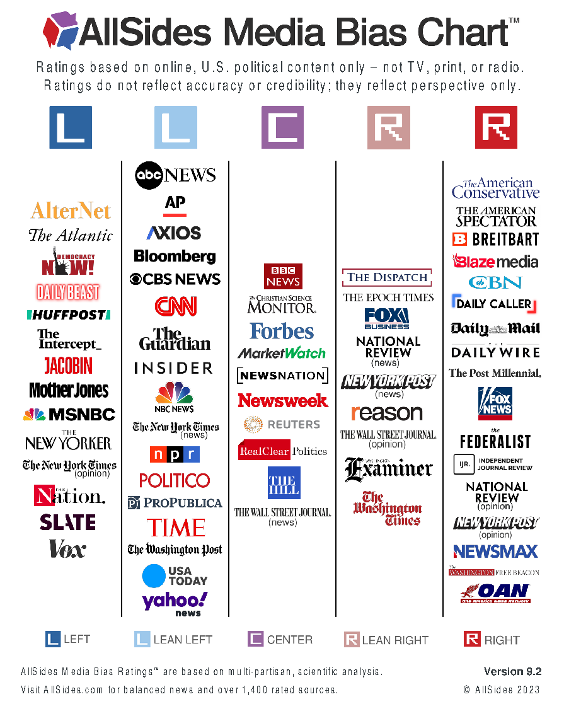
“We the People”, consume news with a Range of Perspectives

