Slide 1
Lessons from IDHE/SDI Fall 2024 Help Desk for Democracy Educators
Rhonda Fitzgerald –Sustained Dialogue Institute
Ande Diaz – Tree of Light Consulting, Emerita-Saint Anselm College
Leslie Garvin –North Carolina Campus Engagement, Nat’l Issues Forum Institute
Michele Holt-Shannon - Carsey School of Public Policy, Univ. of New Hampshire
Nancy Thomas –Institute for Democracy & Higher Education, AAC&U

Slide 2
AGENDA (55 mins)
Come on in to meet us (5 mins)
Connect with a partner or two (10 min)
Content
Learn what the Help Desk fielded (6 mins)
Hear from the Help Desk consultants on the bigger picture from the fields of political engagement, democracy, dialogue, deliberation, & campus climate. (15 mins)
Collaborate : Brainstorm what we need to do collectively to expand those who can “help” in this way (15 mins)
Contact: Stay in touch/resources
Sustained Dialogue Workshop
2

Slide 3
Group Norms To Get Started
What is shared here is confidential
Use “I” statements that don’t assume shared views, demographics, or experiences
Share airtime
Use one another’s names
No recording or screenshots, please
I
3

Slide 4
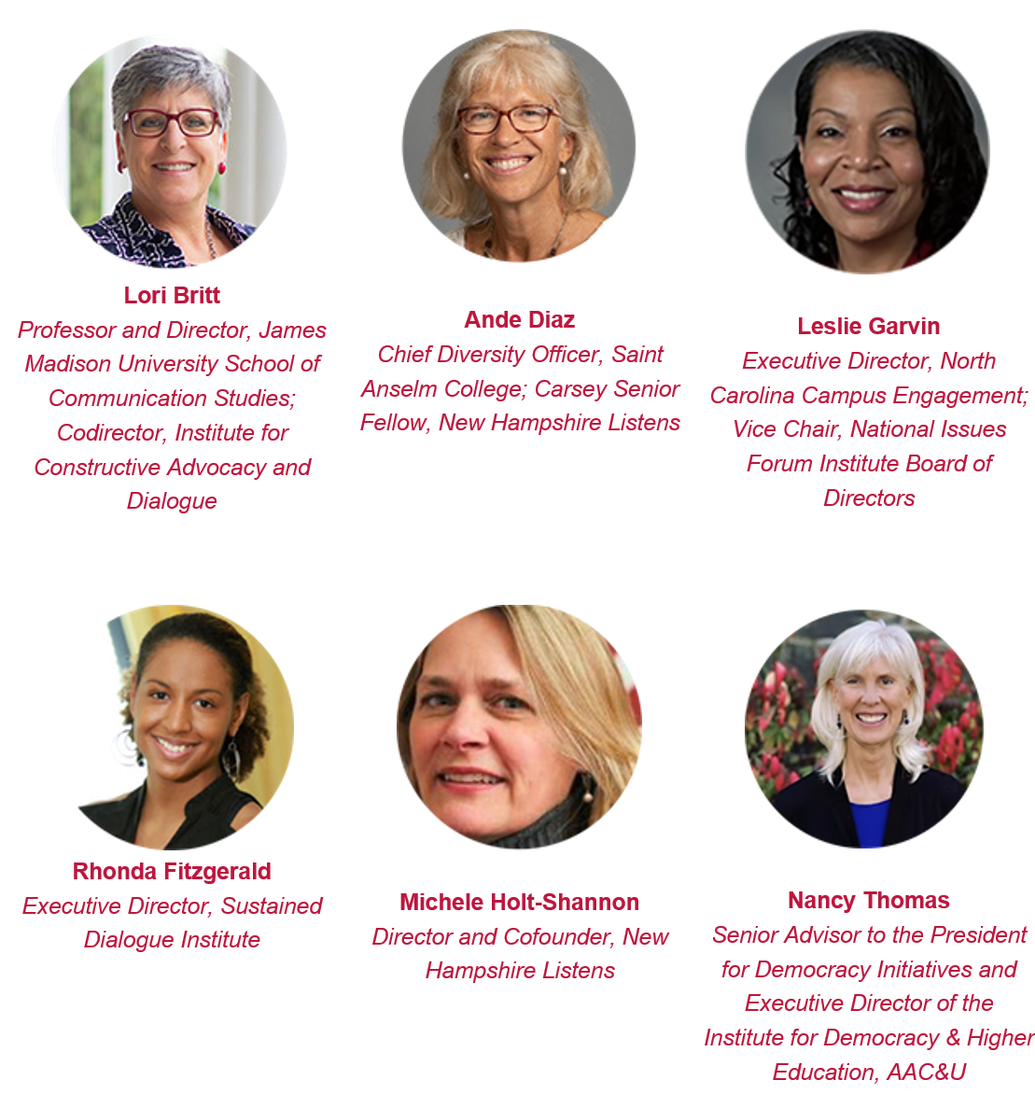
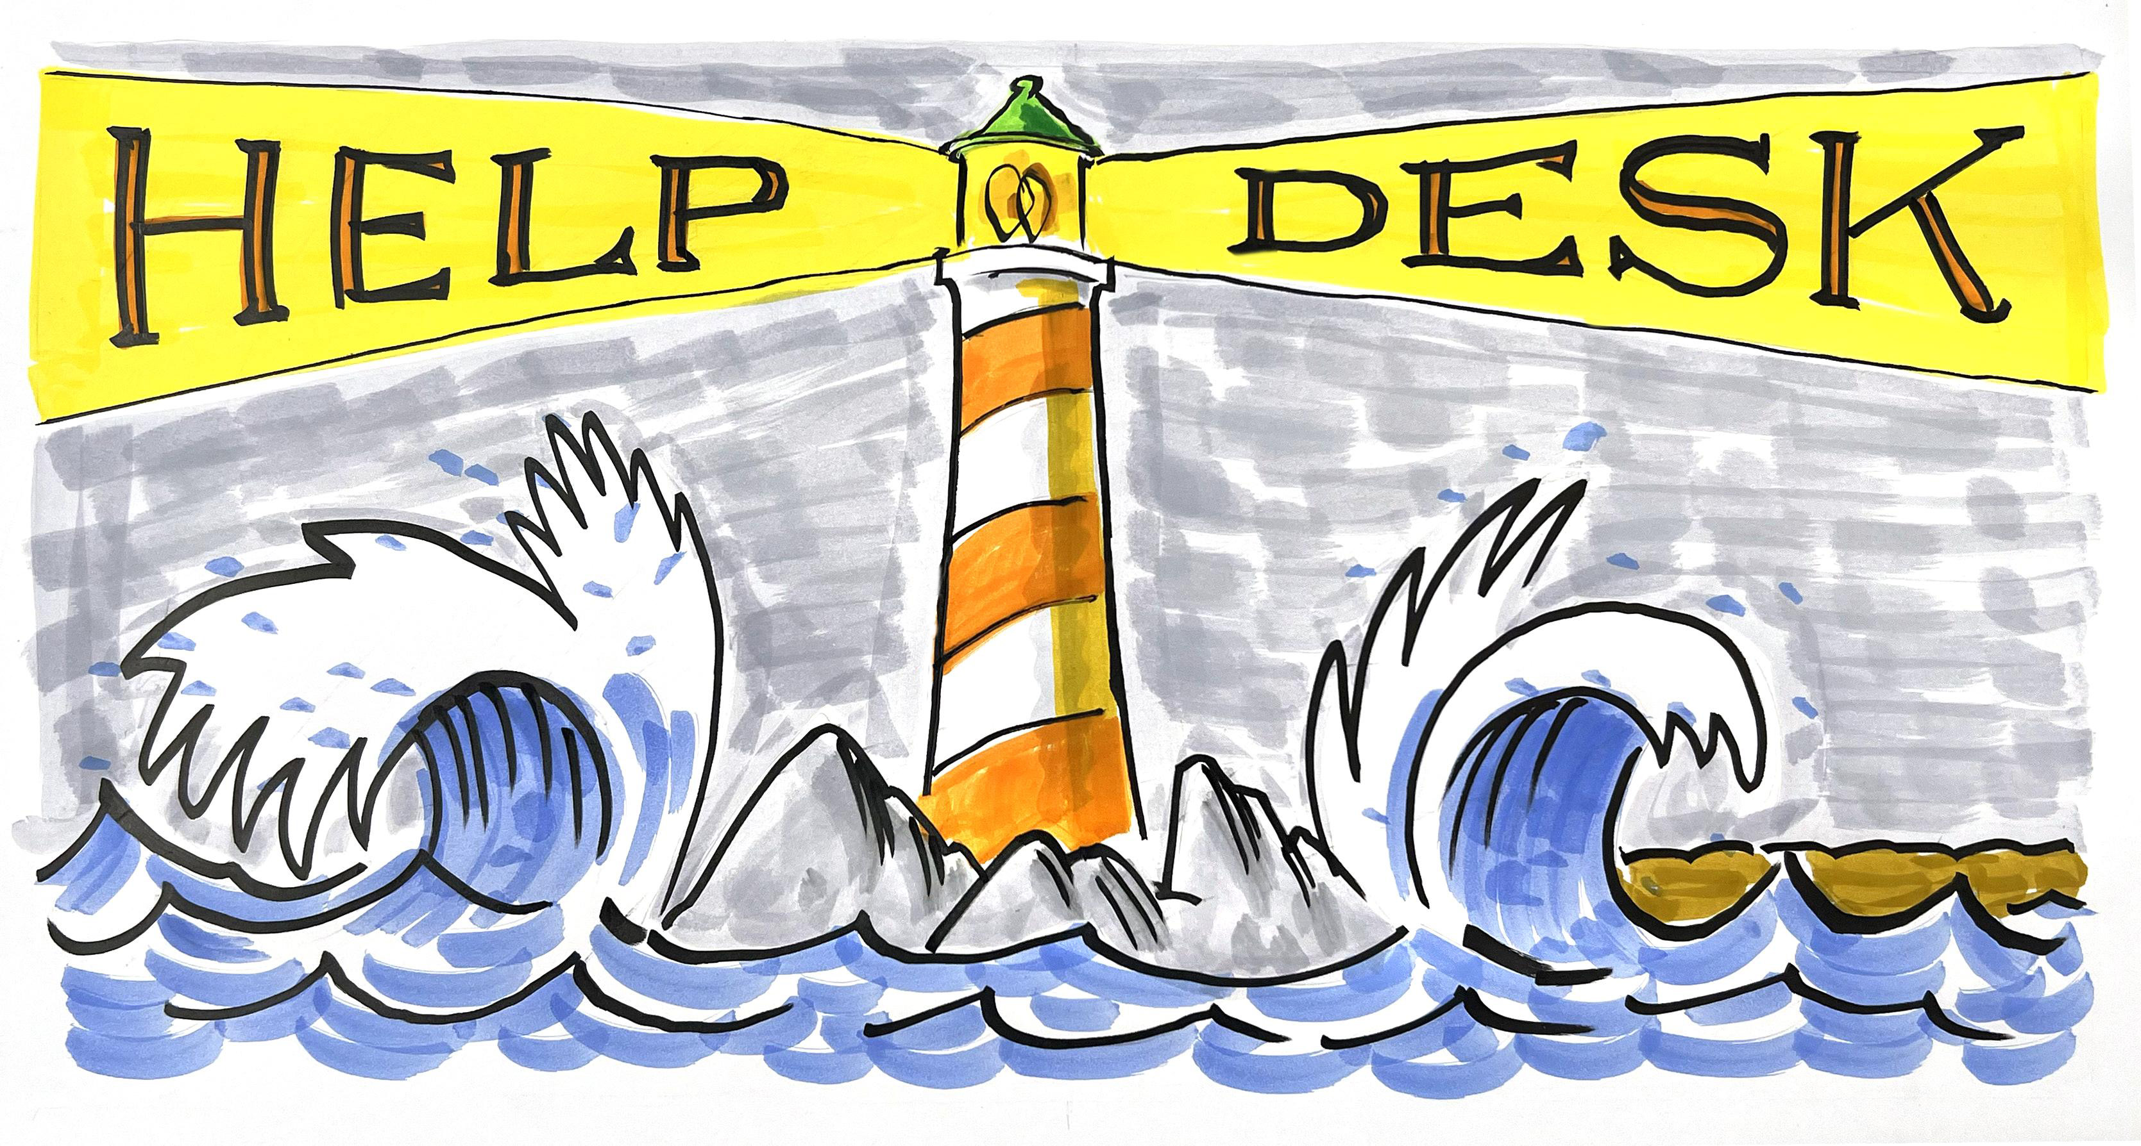
Redesigning Democracy
Workshoppers
Chief Diversity Officer Emerita, Saint Anselm College, VP Special Projects, Tree of Light Consulting Guild

Slide 5
Getting to know you
(pair up, triad okay)
Name
Institution
Current hometown
What’s a type of democratic challenge or conflict you feel confident to advise others around on campus?
How’d you gain that skill or knowledge?
Sustained Dialogue Info Session
5

Slide 6
Background on Conflict & Conversation Help Desk
Launched Sept. 2024 before election and anniversary of 10/7; inquiries from 7 states (goal to expand); publicized through email, network listservs, news articles
Goal: Advise (for free) while addressing democratic challenges educators experience through AMLAP (as many lenses as possible)
Two hosts, one game-changing staffer, seven scholar consultants:
Decade+ of implementation (think immersion - 10,000 skill hours)
Bias for campus-based experience
Formally trained and tested (often in multiple methods)
Ability to think, mix and match many lenses and evidence-based tools
Willingness to say “I do not know.” (17 keyword areas)
Understand partner landscape as dynamic (no outdated information)
Mission-focused and evidence-based (no financial incentive, no funneling toward favorites, no fame incentive)

Slide 7
3 buckets of questions received
Lack of skills/ knowledge to lead in tricky moments:
Building a cross-cultural space, need to check best practices.
Got short training, need real depth on roles, tasks, context
Someone else trying & displaying lack of competence (cultural/ technical)-> potential harm
Missing understanding of law, offices, policy.
Policy making it hard to teach. -> Potential harm (protected class)
Already in conflict. Who can help (fast & free)?
Need one-on-one coaching for escalated situation.
Need to reform how our campus works to be more democratic now
Who provides formal training?
Notes:
(i.e. all steps for organizing for I-P supporter divides, what’s after ground rules?, when and how to intervene in harmful speech, when do I use a separated caucus?)

Slide 8
Recommendations
Ask the Help Desk = set of free, expert partners who can curate.
Field complexity is hard to navigate. Ask potential vendors/partners to provide a multi-year Theory of Change or implementation plan, rather than just one-time training offerings.
Work the muscles in peacetime (clarify democratic commitments and vague policy language.)
Continue to provide educators with up-to-date equity concepts (ex. IDI certification; ‘design for the margins, then the center’; DEI includes veterans, universal design, disability, antisemitism and islamophobia, protected classes)

Slide 9
Help Desk Consultant Panel (15 mins)
What key demographic trends are contributing to the current atmosphere in higher education related to conflictual conversations?
What would you want every educator on campus to know as they seek to navigate conflict and conversations to create a democratic culture?
What larger hopes or advice do you have for those using curricular and/or co-curricular models to encourage democratic engagement?

Slide 10
Collaborate (small group brainstorm – 15 mins)
What would you want/ need to be able to help your campus navigate quicksand moments more democratically? (ex. training, resources, curriculum changes, other boosts)
What’s on your wish list of learning experiences?

Slide 11
Contact Rhonda: Rhonda@sustaineddialogue.org Ande: Andediaz@gmail.com Leslie: Lgarvin@ncengage.org Nancy: Nthomas@aacu.org Michele: Michele.Holt-Shannon@unh.edu also can reach us experts here at the Help Desk: https://www.aacu.org/initiatives/institute-for-democracy-and-higher-education/helpdesk Thank you: AAC&U AAC&U’s Institute for Democracy in Higher Education and Nancy Thomas Anna Dodson The entire Help Desk Scholar/ Consultant volunteer team! Our foundation partners
Sustained Dialogue Workshop
11

